Slide 1
Forming Campus Partnerships to Promote Inclusion

Slide 2
Student ID’s
Our students pay student fees and have UGA ID’s
They can participate in all campus activities and do NOT need segregated options
UGA ID’s give them access to:
Campus buses
Health Center
UGA email addresses
UGA fitness center
UGA sporting events
Access to all library resources

Slide 3
Inclusive Independent Living Skills Instruction
Tip: Use dorm kitchens even if your students do not live in dorms

Slide 4
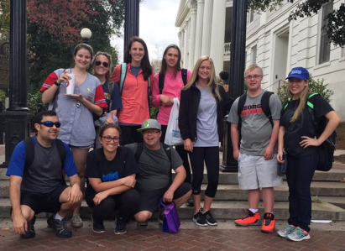
Peer Mentors promote inclusion
Academic​
one-on-one & in-class support, library navigation,
study partners
Health and Wellness​
dining companions, cooking skills,
exercise partners
Social​
student orgs, football games,
volunteer opportunities

Slide 5
Recruiting peer mentors
Peer mentors are UGA students who volunteer
We do not pay any peer mentors to support students
Mentors include our students in their regular on and off-campus activities
Mentors introduce our students to their friends, creating a natural support network

Slide 6
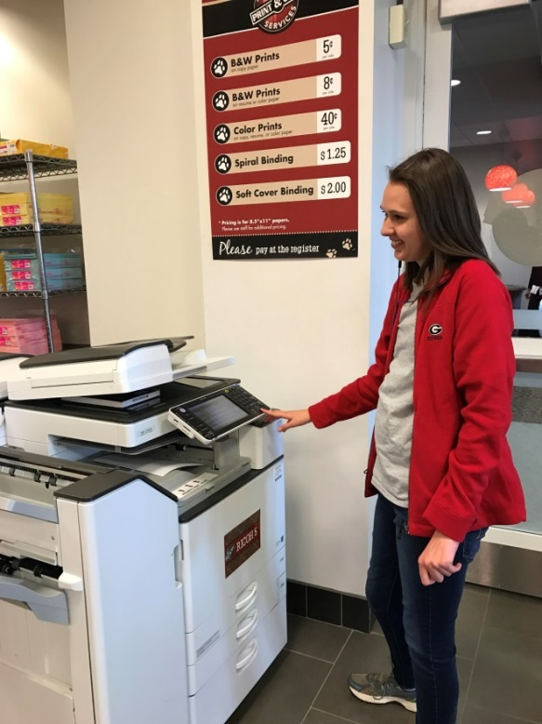
Fully Inclusive Academics
Pre-existing undergraduate courses in bulletin
All we need from professors is a seat in class
We provide all needed accommodations/modifications
Academic Partnerships:
Division of Academic Enhancement
New Media Institute
Counseling and Human Development
Kinesiology

Slide 7
Our students’ first experience with campus inclusion takes place during summer
Summer Youth Leadership Program Goals:
Stay in the dorms with a roommate
Team Building Opportunities
Self-determination activities
Meet current UGA students
Experience classes
Navigate the bus system and dining halls

Slide 8
Our students walk and participate at UGA’s main commencement as well as our college’s commencement

