Slide 1
Statewide Expansion of Inclusive Higher Education: The Role of Collaboration State of the Art Conference, 2019 Beth Leon, Founding Board President Shelby Bates, Education and Outreach Program Coordinator

Slide 2
Initial Discussion
Why you came to this session?

Slide 3
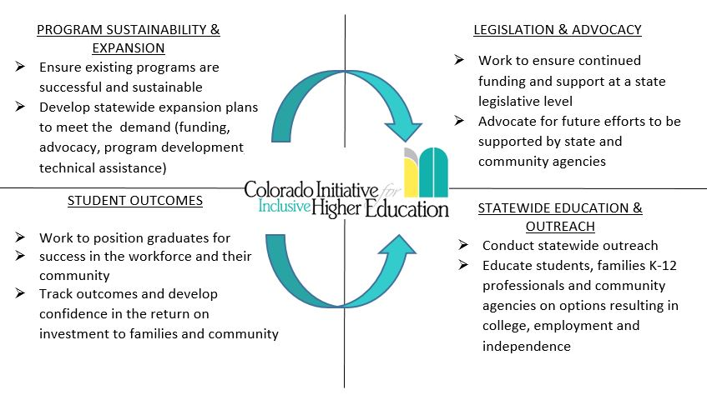
What is IN!?

Slide 4
What does IHE look like?
Applicants are fully matriculated students. ACT/SAT is not required for admission.
Students pay tuition. Grants, scholarships, and financial aid are available.
Students take 2-3 courses in their area of study along with a college and career course designed for IHE students.
Course study is individualized. Students receive accommodations and modifications.
Students receive grades/transcripts, however courses are non-degree credit bearing (transferrable within IHE programs)
Students live inclusively on campus.
Students receive certificate of higher education with emphasis in their chosen field of study (36-72 credit hours.
“ I see a group of young women and men who feel a sense of belonging who otherwise would not have had the opportunity to belong.” -Parent

Slide 5
What is Happening in Colorado?
Enrollment
72 students at 3 colleges (UNC: 21, UCCS: 25, ACC: 26)
Students are from 11 counties and 3 states!
What are students studying?
Advocacy
Brewing Studies
Business
Communications
Education
Human Services
Healthcare
Computer Coding
Government
Graphic Design
Library Science
Photojournalism
Students take 5-6 courses per year to earn certificates of Higher education with an emphasis in their area of study
Certificates are 36, 54, or 72 credit hours
Academics
Living
Students at UNC and UCCS live inclusively in the dorms or student apartments.
100% of college programs are open to students. Students participate on average in 4 activities per week including government, Greek like, student clubs, and athletics.
Social
74% of students had paid employment last school year. Average hours work per week: 9.1
100% of students participate in career development with internships and career readiness education.
Employment
Tuition
Programs are approved for financial aid.

Slide 6
Roots of IN!
Parents at Rocky Mountain Down Syndrome Association
Don Bailey’s Life Learning is for Everyone
South Carolina College Transition Connection
Consultation with George Mason University
Seed funding from RMDSA & house parties
501c3

Slide 7
Board Development
Credibility versus fundraising
Leaders of disability community
Director of Rocky Mountain Down Syndrome Association
President of Arc of Colorado
Director of Easterseals Colorado
University Center of Excellence in Developmental Disabilities
JFK Partners
No autism representation due to timing

Slide 8
Community Needs Assessment
JFK Partners and parent/anthropologist
300+ responses
Distributed by non-profits and disability organizations
Provide data to take to universities

Slide 9
No preference 14%
Out of state 4%
Out of state, only if there are no options in Colorado 7%
In Colorado
52%
In Colorado and only in student’s hometown
23%

Slide 10
Private university 3%
Vocational school
13%
No preference
46%
State
University
17%
Community college
21%

Slide 12
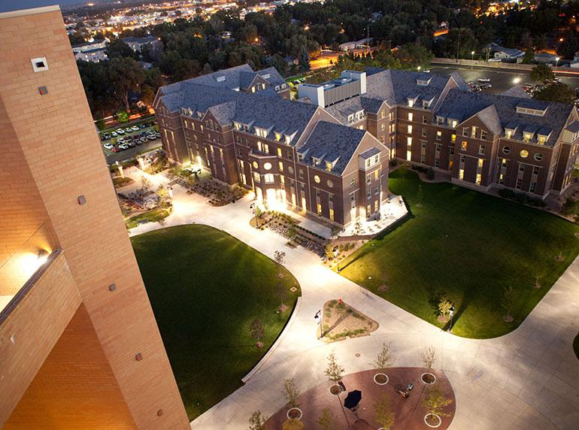
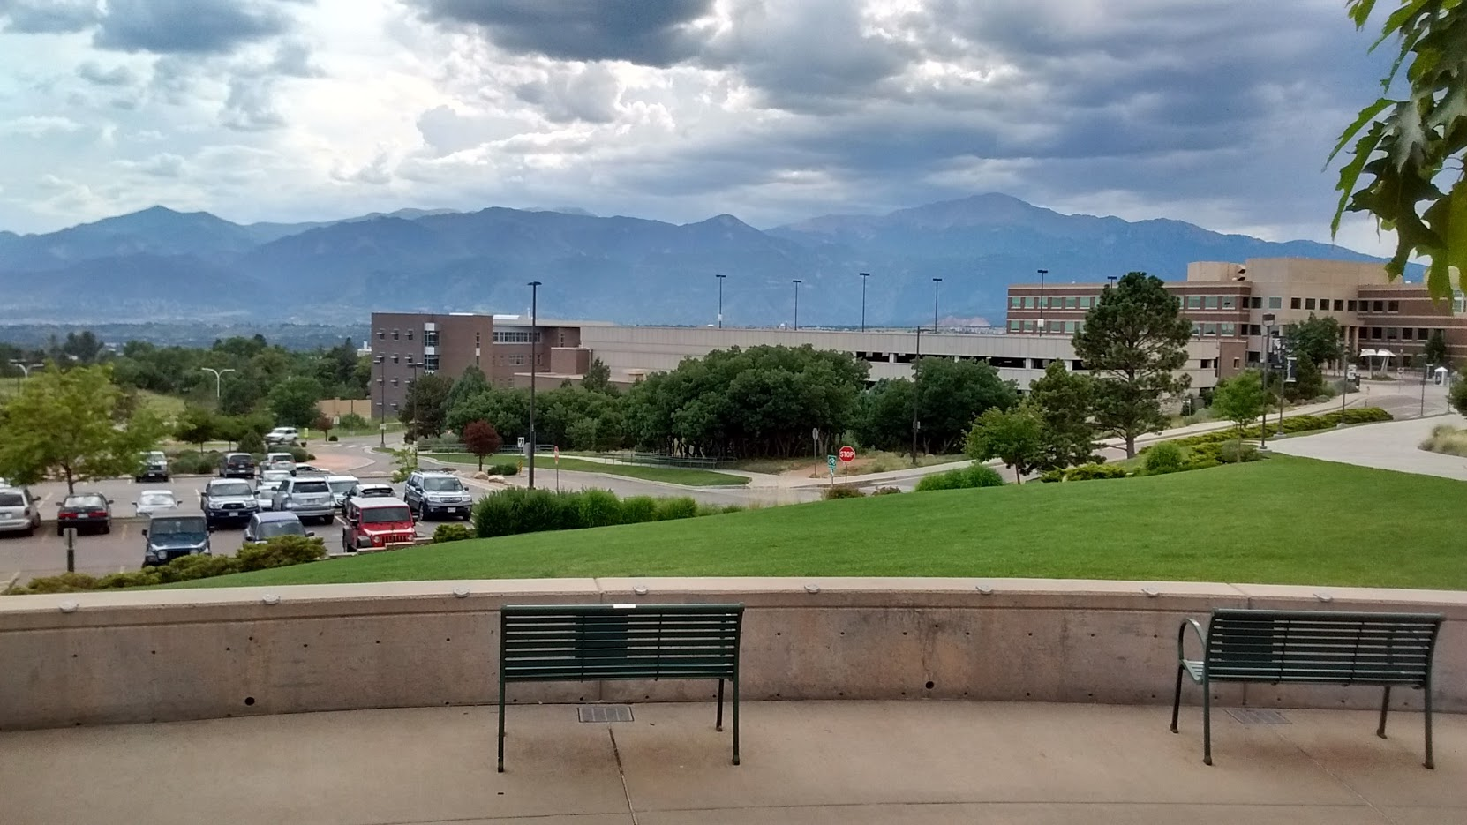
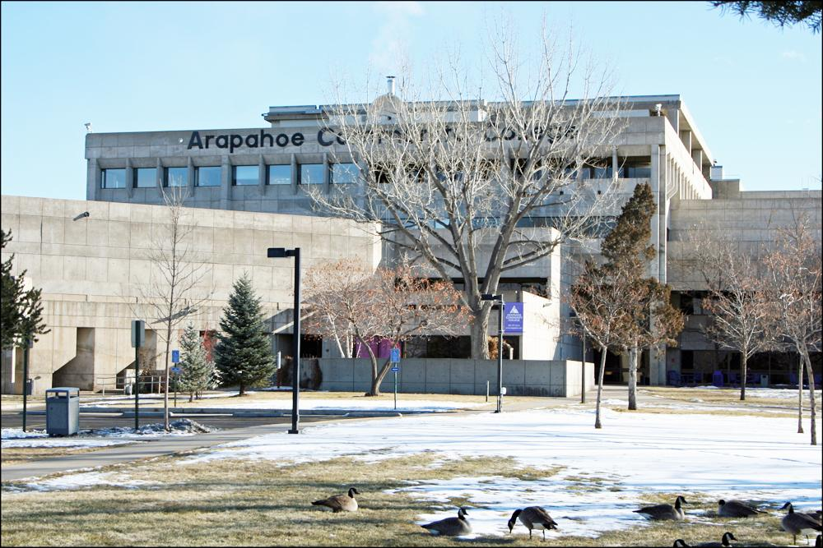
Selecting Pilot Schools
Approached nine schools (private, public, religious)
Identified internal champion via networking
No school disliked idea; several had funding concerns

Slide 13
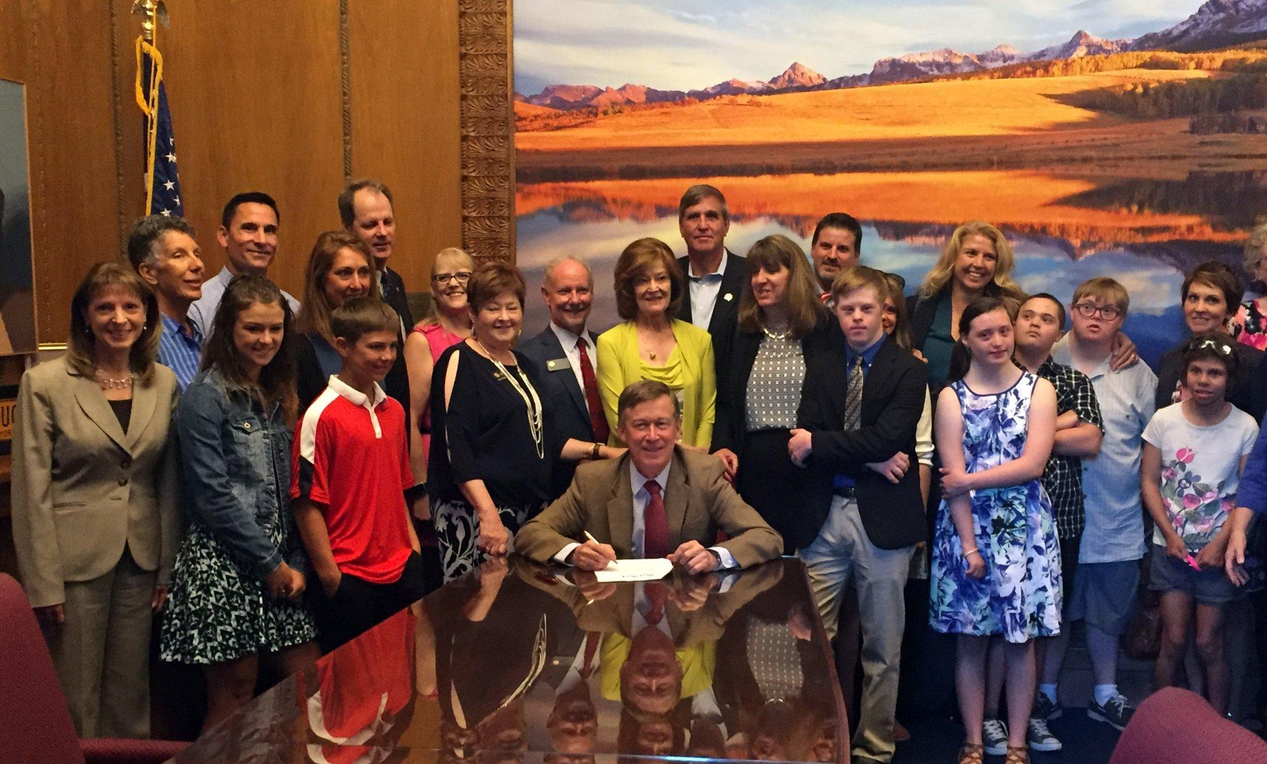
Colorado History Is Made….
Colorado missed TPSID deadline
IN! works with legislature to secure funding options to start up pilot programs
Colorado Senate Bill 16-196: Inclusive Higher Education Act is passed
Key notes
No previous legislative involvement by parents
Federal funds vs. state funds
Bipartisan Bill = huge support
Lobbyist support from community agency (ARC)

Slide 14
Bill Highlights
Funding for three pilot schools for 5 years
Annual evaluation and Institutional assessment for training needs
Students are enrolled with modified admission requirements and have the same rights and responsibilities as typically matriculated students
Students to take a minimum of two classes/semester and one specialized course
Focused on employment and independent living outcomes
Required to develop approved certificate
When program deemed sustainable, become a CTP
Statewide annual summit

Slide 15
Lessons Learned
Start-up time and start up costs
Consider amount of time needed to demonstrate outcomes
IN! received no funding
CTP a requirement, not objective opinion
Graduation requirements (ceremony)
More thorough development of program evaluation metrics (student growth)

Slide 16
IHE Consortium
Led by IN! with members from the pilot schools, JFK Partners and state/community agencies (DVR, CDE)
Bi-Annual large consortium meeting, monthly committee meetings
Function
Problem solving space for cross-institution dialogue
Best practices based on evaluations
Consistency across state
Sub-committees
Division of Vocational Services - DVR
Pilot school advisory groups
State Waiver Supports

Slide 17
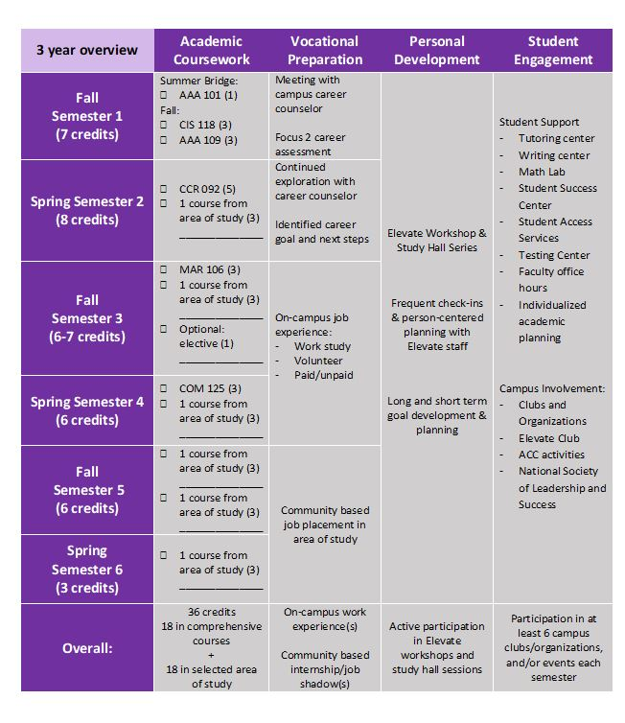
Example Topics
Certificate Development
Walking at graduation
Collaboration with professors
Transferring from community college to university
Code of Conduct
Student Outcomes/Evaluation
Statewide outreach plans
Training

Slide 18
Financials
Initial Funding
Additional Funding Found
Annual Income:
$75K from Senate Bill
$25K from IN! (fundraised)
Cost of program Year 1: ~200K
College/University carried program or found grants/support outside
Reimburse specialized course cost (UNC receives ~$3K per student)
Utilize work study for peer mentors
Determine break even for student enrollment and staff plans (5 year sustainability)
Division of Vocational Rehabilitation

Slide 19
Outreach and Education

Slide 20
Objectives
1) Create awareness that inclusive higher education is an option for students with IDD
2) Guide collaborative systemic change with K-12 grade educators and administration to academically prepare prospective students for the rigor and structure of secondary education
3) Educate prospective students and their families on the needed steps to prepare for college that includes academic preparation, self-advocacy and social independence

Slide 21
Current Goals
Outcome A: Partner with three school districts to pilot a model for district wide dissemination of information to increase awareness of the inclusive higher education options for students with IDD.
Considerations:
What leads to the greatest impact?
How do you ensure everyone in a district knows about inclusive higher education?

Slide 22
Current Goals
Outcome B: Provide 10 professional development trainings to inform best practices on preparing students with IDD for postsecondary education, to include specific trainings tailored to the needs of elementary versus secondary education professionals.
Considerations:
What are the unique needs of educators at each grade level?
What do teacher training programs look like in your state?

Slide 23
Current Goals
Outcome C: Increase statewide efforts to educate prospective students and their families on college preparation and available college options via outreach events in 12 counties, spanning six regions of Colorado.
Considerations:
Where is recruitment not occurring?
Who still does not know what options exist?
What needs exist in rural communities?

Slide 24
Current Goals
Outcome D: Establish partnerships with 8 community-based disability organizations to share information regarding the status and need for inclusive higher education in Colorado.
Considerations:
How can you leverage community partners to support dissemination of information?
How to ensure work is more than a one-time event?

Slide 25
Current Goals
Outcome E: Further develop IN!’s Resource and Educational Marketing Campaign through IN!’s website, eMarketing, videos, webinars, social media, and public relations.
Considerations:
How are people learning about inclusive higher education?

Slide 26
What’s Next for IN!?
Expansion: geographic and type
Increased college prep and readiness in K-12
Vocation: employer training, engagement
Medicaid waiver supports (funding)
Student outcomes - long term
Regional consortium
Permanent Legislation
Scholarship Programs
IHE Credit Transfer
IN! long-term financial sustainability

Slide 27
Discussion
What challenge do you face in your state?
What fears do you have that we can help address?

Slide 28
Contact Information
Tracy Murphy
Executive Director
tracy@inclusivehighered.org
720-629-0196
Shelby Bates
Education and Outreach Program Coordinator
shelbyb@inclusivehighered.org
720-580-1277

