Slide 1
How to develop your leadership skills through campus life
Julliannea Plummer
Michael Zunick
Vivica Black

Slide 2
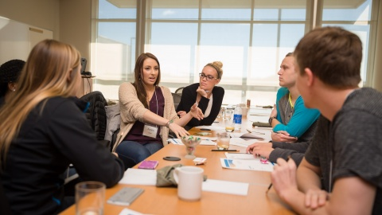
What is leadership?
What is leadership to you?
Leadership is when you have the chance to show people ways to do things and to support people if they are struggling with something
It can also be helping with homework or talking with their professor or advisor to get some more help
A leader is willing to listen and is open minded to people’s opinions
A leader can motivate people and be creative

Slide 3
Why leadership is important ?
Encouraging others to advocate for themselves
Inspiring others to do their best
Helps make you a better person and a good friend
Help you decide on a career path

Slide 4
Facing fears and growing confidence
What are fears you had about starting college?
College is about facing your fears
What helps you grow your confidence to try new things?

Slide 5
Facing fears
You might have questions like:
What kind of questions can I ask? (RIGHT questions)
Is college system the same as high school?
What kind of classes do I need?
How to find my classes?
Who I can ask for help?
Why I need to participate in campus activities?
How to find the RIGHT campus event for me?
Will People look at me because they know about my disability?

Slide 6
Growing confidence
Believe in yourself
Set yourself a challenge ( a goal)
Focus on your positives.
Take care of yourself.
Ask for help from your peers
Don’t be afraid to ask questions

Slide 7
How to get involved in campus activities
Check your college web site, social media, ask your advisor about campus events
Join a club or sports
Involvement fairs
Start your own club
Don’t be afraid to reach out for support.
Check out programs that help you go through college
Do volunteer work or work as a student employee.
Hangout with friends to have group studies, lunch breaks, meet with former classmates, instructors, and advisors. Also meet people you don’t know (They can be your new best friend!)

Slide 8
Highline College Campus Life :
Center of Leadership and Service (CLS)
Students Clubs
Multicultural Affairs
ACHIEVE
Bookstore
Career and Student Employment (CASE)
Computer lab
Inter-Cultural Center
Library
Math Resources Center
MESA Program
Tutoring Center
TRIO Program
Tutor Lab (Get help with Graphic Design)
Veterans Services
Writing Center
First Fridays Institute
Counseling Center
Fitness Center
Performing Arts
Student Government
The Thunderword (Student Newspaper)
Advising
Food Pantry and more …

Slide 9
Highline College students clubs:
• Anime Club
• Cooking Club
• Arabic Club
• CRU Club
• Archaeologist Anonymous
• Cyber Threat Intelligence Club
• (The) Artist Collective
• Highline Mass Choir
• Bhutanese Student Club
• Latin X Student Association
• Black Student Union
• Non-Traditional Student Club
• Book sharing Club
• Pacific Islanders
• Biology Club **
• Permaculture Club
• Calligraphy Club•
• Space Jam
• Chess / Go Club **
• Veterans Club
• Computer Science Club
• Dance Club
• Entrepreneurship Club **
• Game Club
• Momma's Club Goal Digger
• HC Bicycle Club
• Health & Happiness Club
• Highline College Conservatives
• Highline Table Tennis Club
• Highline Underground Open Mic Club **
• #Horror Life Club
• Hospitality & Tourism Management Students Association
• Snowboarding Club

Slide 10
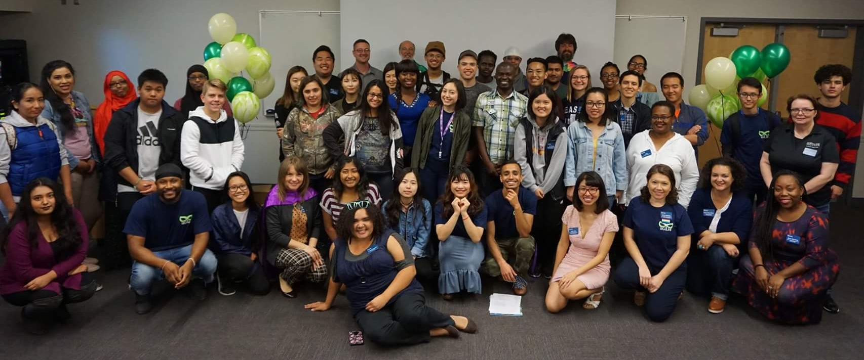
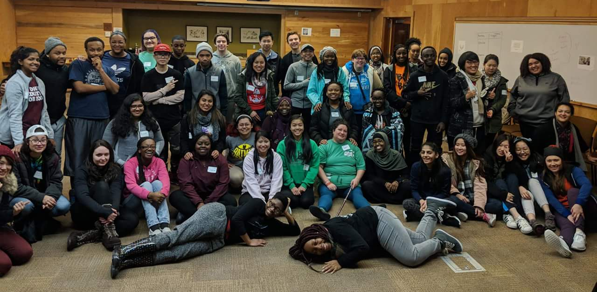
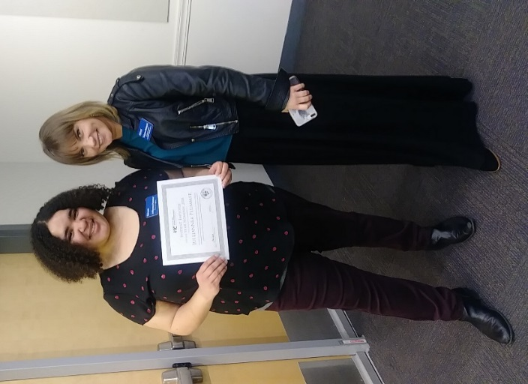
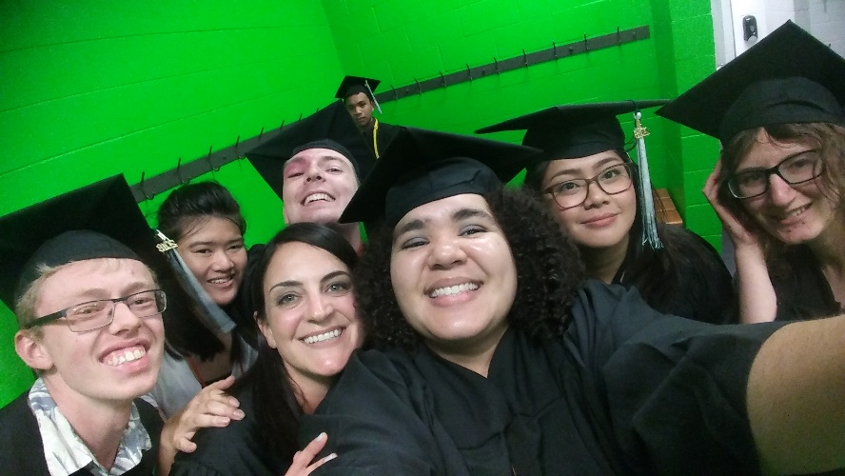
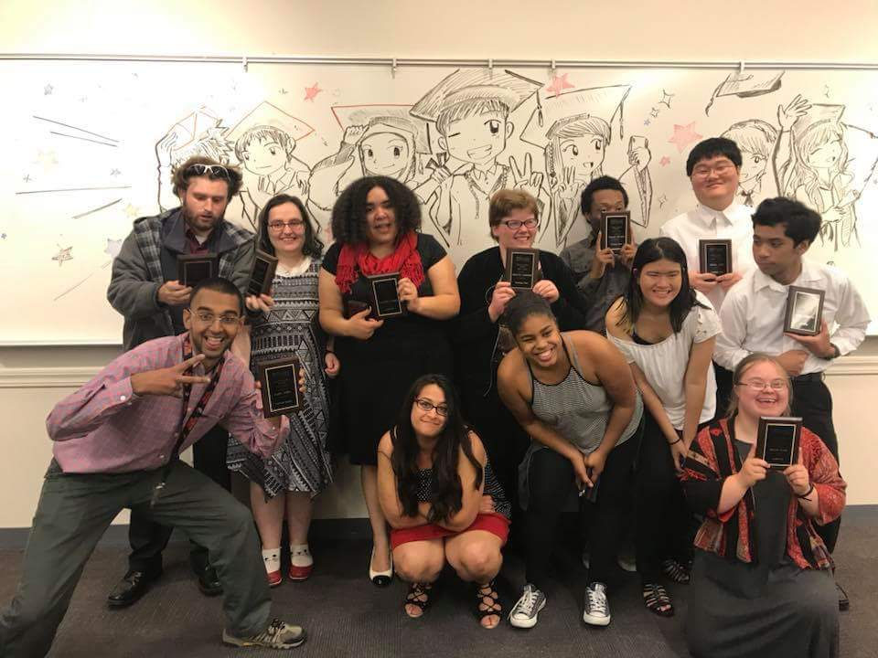
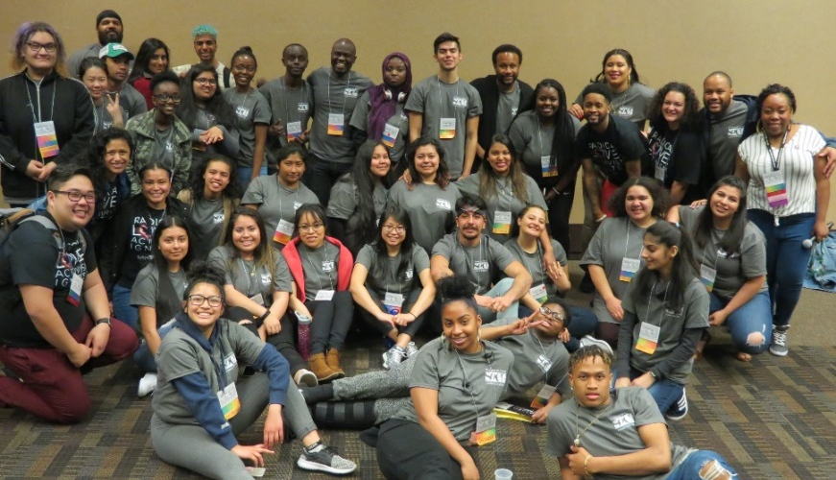
Julliannea’s experience at Highline
My College and DVR Experience Before ACHIEVE
Experience with ACHIEVE & Highline College
After ACHIEVE

Slide 11
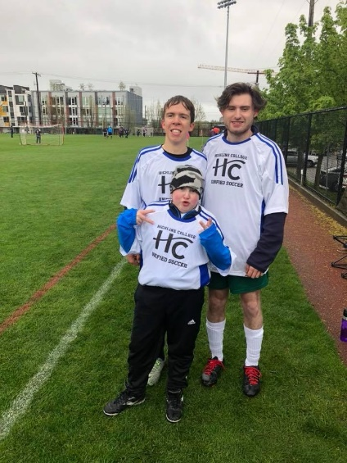
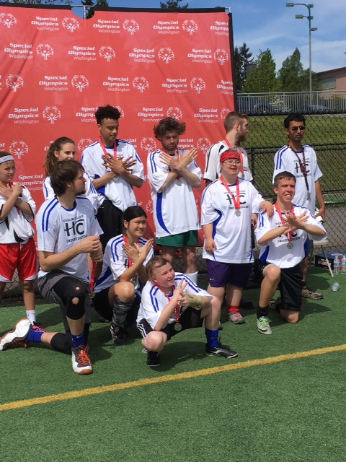
Michael’s campus life experience
When I first came to Highline, I requested a lot of support. But now, I’m a Peer Navigator helping others.
I played on Highline College unified soccer team last year in the spring!!
We had soccer practice every Thursday and on the weekend we had our soccer matches at Ingraham High School and we would play 5 v 5. We had districts and Highline College finished second place in their division and advanced to compete in state soccer tournament.
The coach of our team decided move us to the 7 v 7 division at the state soccer tournament and that was a lot more work because the field was bigger and wider. We won gold out of the loser bracket in our division. We had to play the same team in the first game and in the championship match and we beat them.

Slide 12
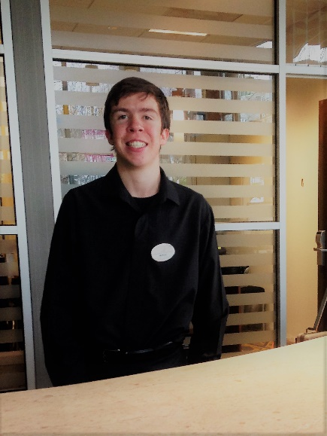
Michael’s campus life experience
I had an internship for 11 weeks at the Water Town Hotel and I worked as a front desk assistant. It gave me so much confidence in working. When I worked my shift started at 7:00 in the morning and ended at 9:30 on Monday and at noon on Friday.
I also did cooking club where we made a different kinds of food and hungout with friends. One time, I really enjoyed learning about how to cook a steak on the grill and tasting it after cooking it made me think I would like to cook a steak all by myself!!

Slide 13
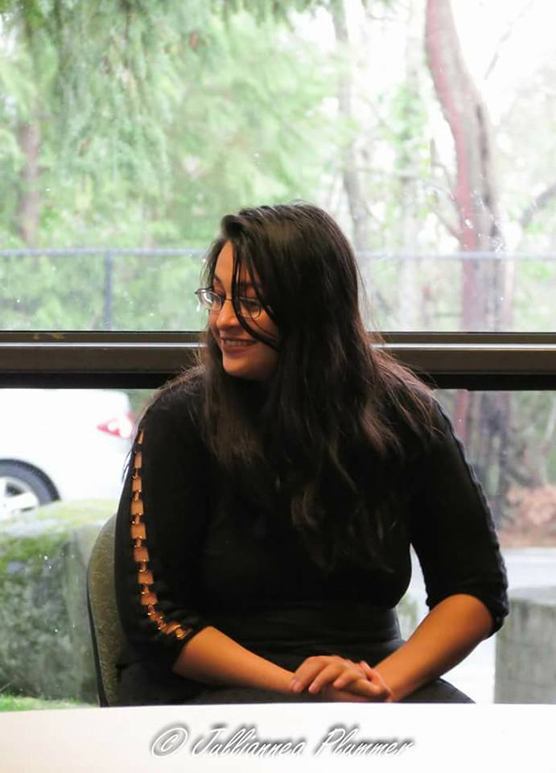
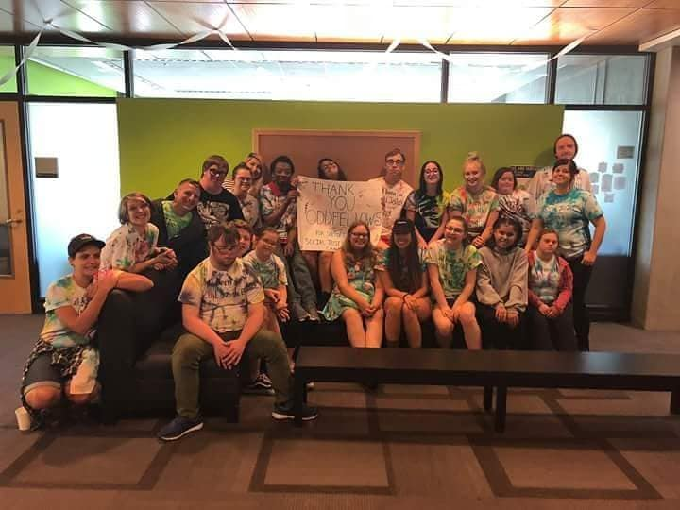
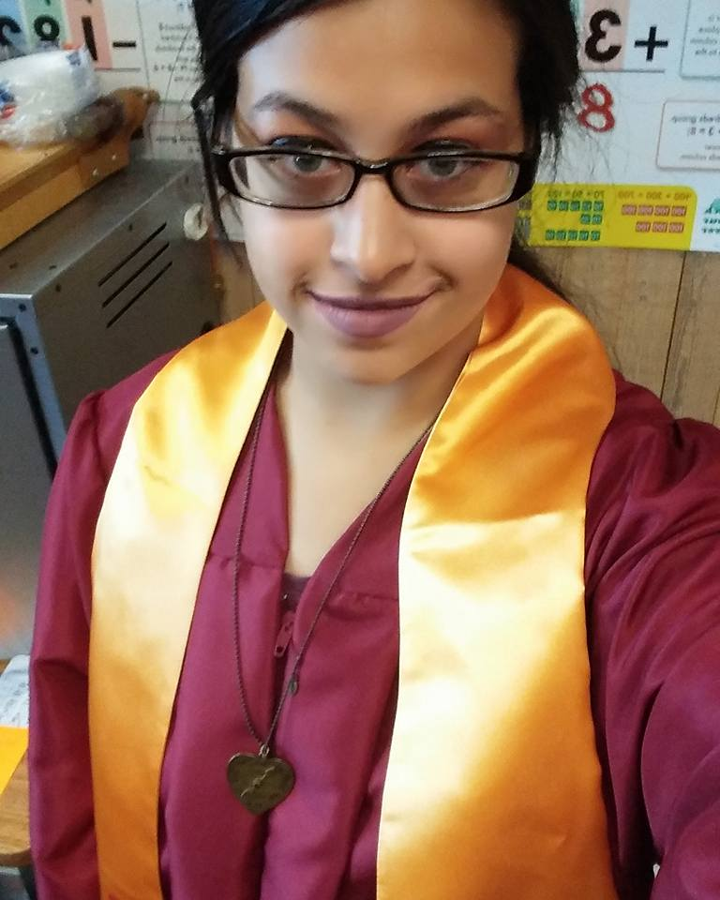
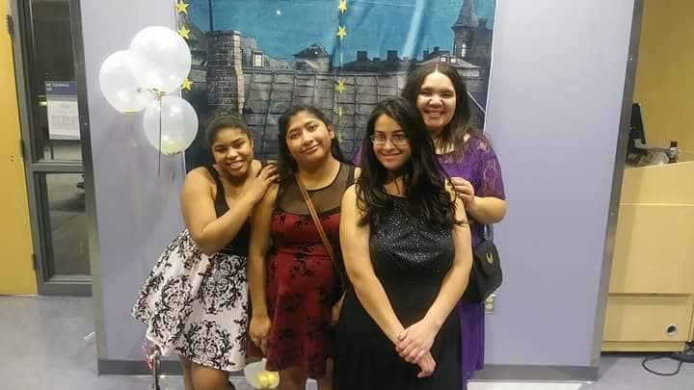
Vivica Black
Before I went to Highline College
My Experience At Highline College

Slide 14
How to make the most of your campus experience
Be present as much as you can.
Explore different opportunities to find your true passion
Talk to other students.
Try new things
Make new friends
Get involved
Learn to manage stress and anxiety
When you need help, ask for help!

Slide 15
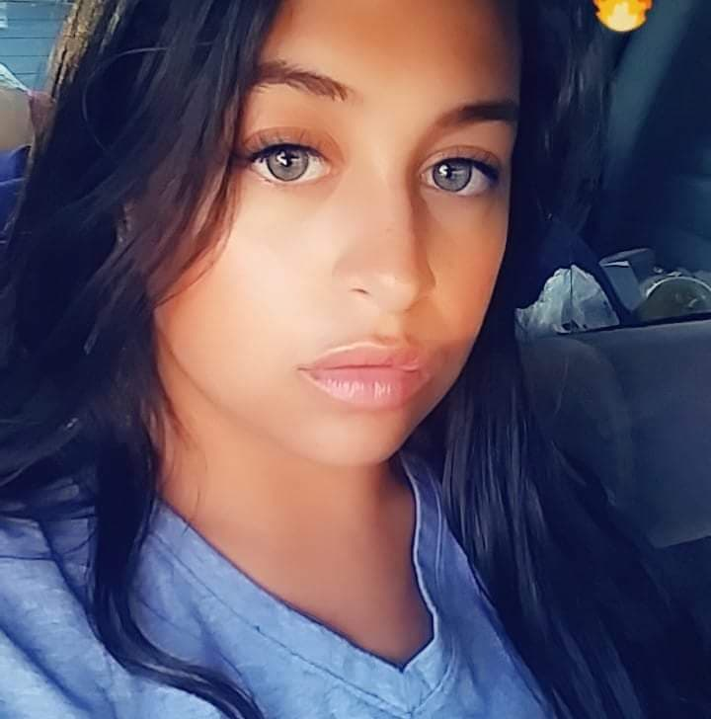
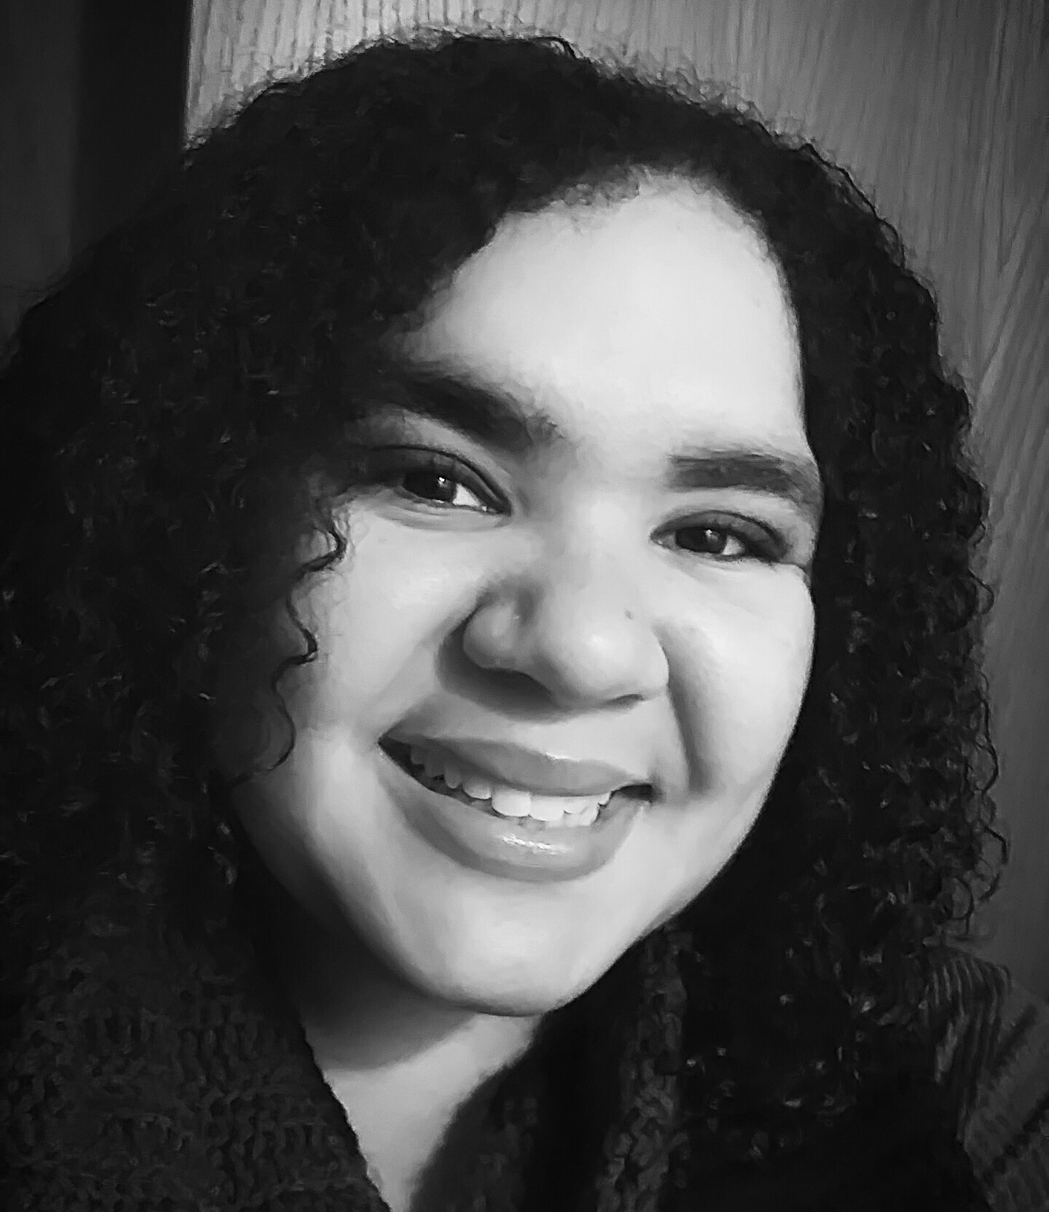
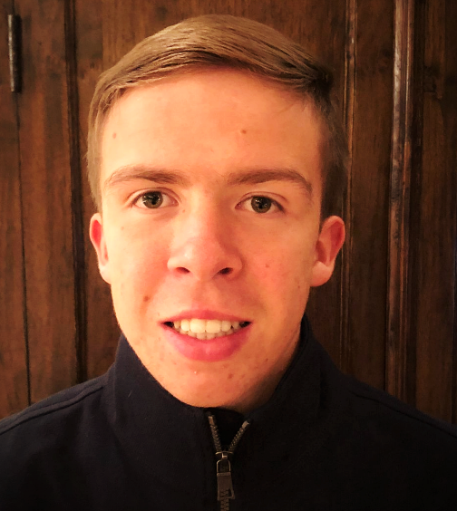
Information Contacts
Vivica Black
vivicablack@students.highline.edu
Julliannea Plummer
plumgirl21@students.highline.edu
Michael Zunick
michaelzunick@students.highline.edu

Slide 16
Thank you!

